Slide 1
Stakeholder Update on the Coordinated Care Initiative April 23, 2014 Margaret Tatar Department of Health Care Services (DHCS)

Slide 2
Today’s Webinar
Cal MediConnect Enrollment Data
Enrollment Materials – new policy for Cal MediConnect alternative formats

Slide 3
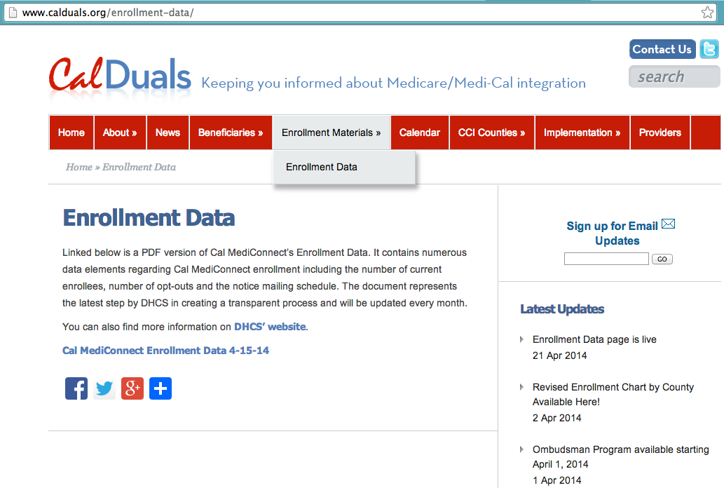
How to Access Enrollment Data

Slide 4
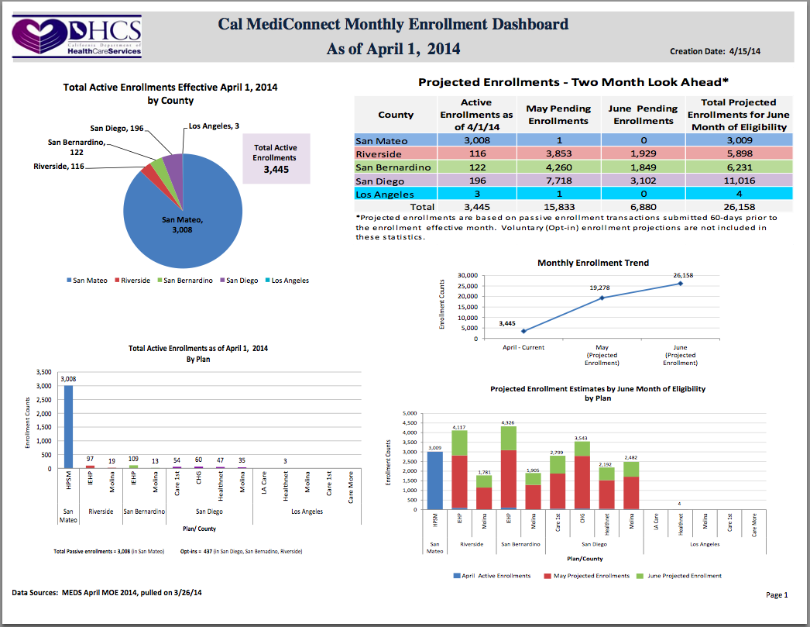
Enrollment Data March: Page 1

Slide 5
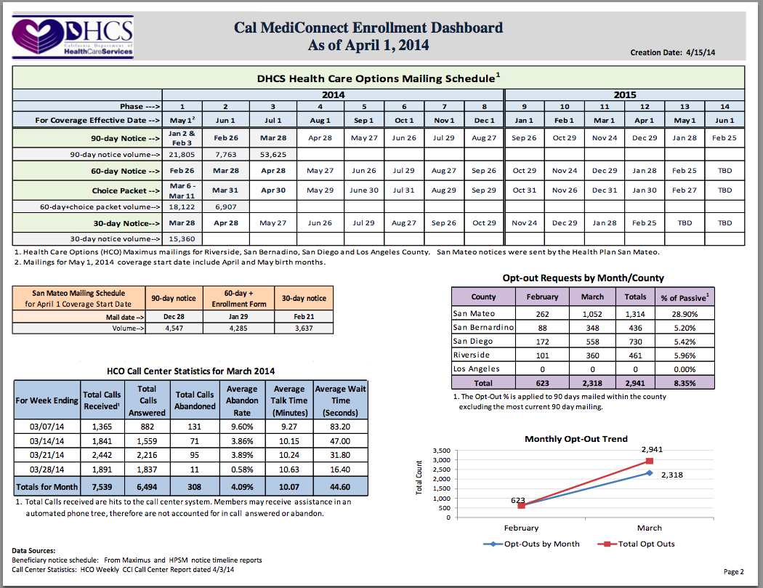
Enrollment Data March: Page 2

Slide 6
Notices in Alternative Formats
Medi-Cal and Cal MediConnect materials available on demand in Braille, audio & large print
Moving forward, streamlined for Cal MediConnect enrollment notices
90/60/30 day notices
Guidebook
Choice book
Other notices remain on demand as we assess process

Slide 7
Questions
info@calduals.org
www.calduals.org

