Slide 1
Iniciativa de Atención Coordinada de California
Condado de Los Ángeles

Slide 2
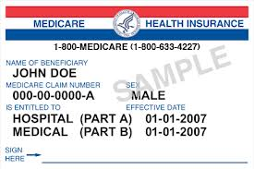
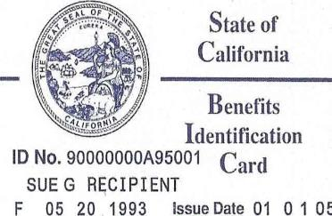
Medicare y Medi-Cal hoy
Medicare
Medi-Cal
Notes:
Medicare and Medi-Cal are two different government programs to provide health care. Medicare is for seniors and those under 65 with certain disabilities, such as end-stage renal disease (ESRD). Medi-Cal is for low-income Californians. There are some Californians who qualify for BOTH programs, called Medi-Medi or dual eligible beneficiaries. They receive complementary services from each program. Medicare primarily covers medical services and prescription drugs, and Medi-Cal wraps additional services around that: help with transportation, vision, dental, cost sharing, long-term care, and durable medical equipment (DME). Medi-Cal also covers long-term services and supports including in-home supportive services (IHSS), community-based adult services (CBAS), the Multipurpose Senior Services Program (MSSP) and nursing home care.

Slide 3
Medicare y Medi-Cal hoy
Medicare
Medi-Cal
Apoyos y servicios a largo plazo
MSSP: Servicios de Propósitos Múltiples para Adultos Mayores
IHSS: Servicios de apoyo en el hogar
CBAS: Servicios para adultos basados en la comunidad
Instalaciones de enfermería
Equipo médico duradero
Costos compartidos de Medicare
Médicos
Hospitales
Medicamentos con receta médica
Notes:
Medicare and Medi-Cal are two different government programs to provide health care. Medicare is for seniors and those under 65 with certain disabilities, such as end-stage renal disease (ESRD). Medi-Cal is for low-income Californians. There are some Californians who qualify for BOTH programs, called Medi-Medi or dual eligible beneficiaries. They receive complementary services from each program. Medicare primarily covers medical services and prescription drugs, and Medi-Cal wraps additional services around that: help with transportation, vision, dental, cost sharing, long-term care, and durable medical equipment (DME). Medi-Cal also covers long-term services and supports including in-home supportive services (IHSS), community-based adult services (CBAS), the Multipurpose Senior Services Program (MSSP) and nursing home care.

Slide 4
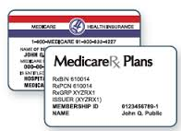
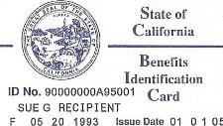
La Ley de Iniciativa de Atención Coordinada: Dos partes
Cal MediConnect
Medi-Cal
Administrado a largo plazo
Apoyos y servicios a largo plazo (MLTSS)
Quién: la mayoría de personas que tienen Medicare (parte A y parte B) y beneficios completos de Medi-Cal
Quién: Beneficiarios solo de Medi-Cal y personas que tienen Medicare y Medi-Cal quienes eligen no unirse a Cal MediConnect
Opcional
Obligatorio
Notes:
Many dual eligible beneficiaries in the eight counties will be eligible to enroll in a new program – Cal MediConnect. This program is optional, and beneficiaries will have a choice of plans that will combine their Medicare and Medi-Cal benefits and provide additional benefits and services, including care coordination.
Those who are not eligible for Cal MediConnect, or who opt out, will still have to choose a Medi-Cal managed care plan to receive their long-term services and supports. Their Medicare benefits will not change, whether they are in FFS or a Medicare Advantage plan.

Slide 5
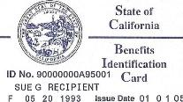
Combina original Medicare (partes A, B y D) y servicios de Medi-Cal
Tendran un solo número telefonico para administrar sus necesidades de atención médica
Beneficio de la vista: un examen de la vista de rutina al año y el plan contribuira $100 para anteojos/lentes de contacto cada dos años
Beneficio de transporte: 30 viajes de una vía al año además del beneficio de transporte existente
Coordinación del cuidado de la salud
Llame al plan de salud para averiguar si su proveedor trabaja con el plan
Cal MediConnect
Quién: si usted tiene Medicare (partes A, B y D) y beneficios completos de Medi-Cal
Opcional
Notes:
Beneficiaries who are not eligible for Cal MediConnect or who choose to opt out will still need to enroll in a Medi-Cal managed care plan Medi-Cal Beneficiaries will receive some supplemental vision benefits. Their Medicare benefits will remain the same, whether they are delivered through Medicare FFS or Medicare Advantage.

Slide 6
Cal MediConnect
Coordinación del cuidado de la salud
Notes:
In Cal MediConnect, beneficiaries and their providers will have access to a number of care coordination tools.

Slide 7
Si tiene Medicare y Medi-Cal
Opción 1: Elija Cal MediConnect
Puede combinar sus beneficios de Medicare A, B y D con los de Medi-Cal en un plan Cal MediConnect
Care 1st
Cal MediConnect
CareMore
Cal MediConnect
Health Net
Cal MediConnect
L.A. Care
Cal MediConnect
Molina Dual Options

Slide 8
Planes Cal MediConnect en Los Angeles
Los Ángeles
Care 1st Cal MediConnect
CareMore Cal MediConnect
Health Net Cal MediConnect
L.A. Care Cal MediConnect
Molina Dual Options
Notes:
The health plan options in each county are different. Beneficiaries will receive information about each plan, including their provider networks, 60 days before enrollment. The state will identify the plan that includes the providers beneficiaries currently are seeing.

Slide 9
Cal MediConnect Costo y copagos
No hay costos adicionales asociados con unirse al plan Cal MediConnect.
Verifique con el plan Cal MediConnect acerca de los costos asociados con la parte D de Medicare y para asegurarse de que sus medicamentos están cubiertos.
Los copagos serán iguales a los de ahora.
Si usted es Medi-Medi, sus proveedores no deben mandarle ningun tipo de cobros y esto seguirá igual bajo Cal MediConnect.
Notes:
Neither Cal MediConnect nor MLTSS should change costs for beneficiaries.

Slide 10
Medi-Cal
Servicios Y Apoyo Administrados de largo plazo
Esto afecta solo sus servicios de Medi-Cal.
Usted seguirá recibiendo los mismos servicios de Medi-Cal, ahora estos serán a través de un plan de salud.
Si tiene Medicare y Medi-Cal y elije unirse a este plan, sus médicos, hospitales y otros servicios de Medicare permanecerán igual que hasta hoy.
Quién:
Si tiene solo Medi-Cal
O si tiene Medicare y Medi-Cal y no se une a Cal MediConnect
Obligatorio
Notes:
Beneficiaries who are not eligible for Cal MediConnect or who choose to opt out will still need to enroll in a Medi-Cal managed care plan Medi-Cal Beneficiaries will receive some supplemental vision benefits. Their Medicare benefits will remain the same, whether they are delivered through Medicare FFS or Medicare Advantage.

Slide 11
Si tiene Medicare y Medi-Cal
Opción 2: Conserve su Medicare como está y únase al plan de salud de Medi-Cal
Su Medicare incluyendo su plan de la Parte D seguirá igual
Usted continuará usando los mismos proveedores de Medicare
Sus beneficios Medi-Cal ahora están asignados al plan de salud de Medi-Cal
Inscríbase solo en un plan Medi-Cal
Health
Net
L.A. Care Medi-Cal
Molina
Health Plan
Care 1st Health Plan
Kaiser
Permanente
Anthem

Slide 12
Si tiene Medi-Cal
Debe elegir un plan Medi-Cal para sus beneficios de Medi-Cal
Inscríbase solo en un plan Medi-Cal
Health
Net
L.A. Care Medi-Cal
Molina
Health Plan
Care 1st Health Plan
Kaiser
Permanente
Anthem

Slide 13
Planes Medi-Cal
Los Ángeles
L.A Care Medi-Cal Plan
Health Net
Molina Health Plan
Anthem
Care 1st Health Plan
Kaiser Permanente
Notes:
The health plan options in each county are different. Beneficiaries will receive information about each plan, including their provider networks, 60 days before enrollment. The state will identify the plan that includes the providers beneficiaries currently are seeing.

Slide 14
PACE
Programa Todo Incluido
Cuidado para los Adultos Mayores
Usted puede ser elegible para inscribirse en un programa PACE
Si usted:
Es mayor de 55 años
Vive en su casa o en la comunidad de manera segura
Necesita un alto nivel de atención para una discapacidad o condición crónica
Vive en un código postal con servicio de un plan de salud PACE
Quién: si tiene Medicare y Medi-Cal o solo Medi-Cal
Opción disponible para las personas que son elegibles
Notes:
One option for those who do not want to go into Cal MediConnect is the PACE program. This is available only to some Medi-Medi beneficiaries. It is similar to Cal MediConnect in that it combines Medicare and Medi-Cal services to help provide care coordination to beneficiaries, but it has more restrictions than Cal MediConnect.

Slide 15
Planes PACE
Los Ángeles
Altamed Senior BuenaCare
Centros para atención a adultos mayores Brandman
1-877-462-2582
1-818-774-3065
Notes:
The health plan options in each county are different. Beneficiaries will receive information about each plan, including their provider networks, 60 days before enrollment. The state will identify the plan that includes the providers beneficiaries currently are seeing.

Slide 16
Cuándo esperar avisos
Recibirá avisos 90, 60 y 30 días antes de su fecha de cobertura.
Para la mayoría de personas, su fecha de cobertura es el primer día de su mes de nacimiento.
La información oficial de Cal MediConnect del estado solo llegará en sobres azules.
Notes:
Most beneficiaries will receive three notices prior to their coverage date – this is for beneficiaries who are eligible for Cal MediConnect and beneficiaries who are currently enrolled in Medi-Cal fee-for-service. Beneficiaries who are already in Medi-Cal managed care plans and will only see their LTSS benefits move to the managed care plan will receive a notice 45 days before that occurs.
Coverage dates for individuals will vary by county and by eligibility status. For many it will be their birth month.
Cal MediConnect official information will arrive in blue envelopes. Beneficiaries in San Mateo County will receive notices from their local health plan. MLTSS eligible beneficiaries in other counties will receive regular notices from the state.

Slide 17
Busque el sobre azul

Slide 18
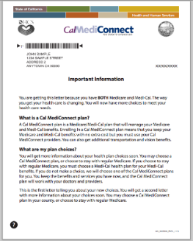
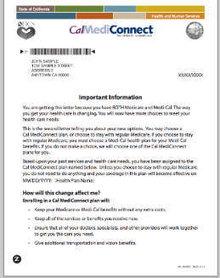
Avisos de Cal MediConnect
Aviso de 90 días
Aviso de 60 días
Aviso de 30 días

Slide 19
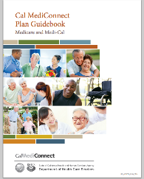
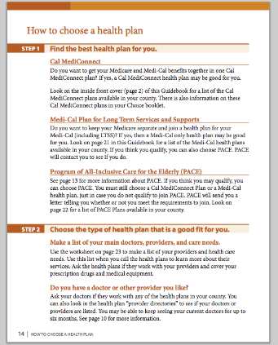
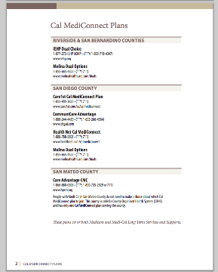
Guía de Cal MediConnect

Slide 20
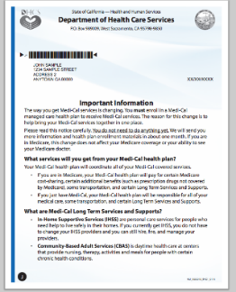
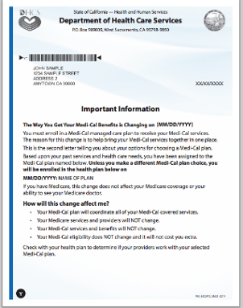
MLTSS
Aviso de 90 días
Aviso de 60 días
Aviso de 30 días

Slide 21
Llame a Health Care Options
Llame a Health Care Options para:
Inscribirse en un plan Cal MediConnect o
Inscribirse solo en un plan Medi-Cal (y conserve su Medicare como está hoy) o
Inscribirse en un plan PACE
1-844-580-7272

Slide 22
Use el formulario de opciones para elegir el plan que desea
Si tiene Medicare y Medi-Cal y no hace nada:
Se le asignará al plan Cal MediConnect que es la mejor opción para usted.
Si tiene solo Medi-cal y no hace nada:
Se le asignará a un plan Medi-Cal que es la mejor opción para usted.
De esta manera usted no perderá sus beneficios o servicios de Medicare o Medi-Cal.
Notes:
Neither Cal MediConnect nor MLTSS should change costs for beneficiaries.

Slide 23
Si necesita ayuda, pídala al Plan
Planes de Cal MediConnect
Care 1st Cal MediConnect 1-855-905-3825
CareMore Cal MediConnect 1-888-350-3447
Health Net Cal MediConnect 1-855-905-3825
L.A. Care Cal MediConnect 1-888-788-5395
Molina Dual Options 1-855-665-4627
Notes:
There are county-specific fact sheets that will be posting to Cal Duals with phone numbers for plans and HICAPs in each area.

Slide 24
A quién llamar
Si tiene alguna queja, llame a su plan de salud.
Si necesita más ayuda, puede llamar a:
Programa del Defensor de Cal MediConnect | (855) 501-3077
Defensor de Atención Administrada de Medi-Cal | (888) 452-8609
Oficina del Asesor de Pacientes | (866) 466-8900

Slide 25
Programa del Defensor de Cal MediConnect
Si está en un plan de salud de Cal MediConnect puede llamar al Defensor
El Defensor puede ayudarle a presentar apelaciones y quejas
(855) 501-3077

Slide 26
Recursos adicionales
Programa de Defensa y Asesoramiento de Seguro de Salud (Health Insurance Counseling and Advocacy Program, HICAP)
Llame a HICAP para ayudarle a tomar la decisión correcta para usted
213-383-4519
Línea directa: 1-800-434-0222
Correo electrónico info@calduals.org

